Slide 1


National Health Approach to biological Hazards:-
Dr MOHD ALHAJRI
Director of EPRD
MOPH

Slide 2
CONTENTS:
A brief overview of biological hazards.
- priority biological hazards in MOPH Qatar.
- Qatar National preparedness and response approach.
- practical examples ( local).
- international approach:-
  world health organization lead and guidance
  IHR 2005.
  REGIONAL COLLABORATIONS.

Slide 3
1- A brief overview of biological hazards:
Biohazards:- organisms or products of organisms that present a risk to humans
  Inherently different from chemicals, physical agents, carcinogens, etc.
  BUT, recognition, evaluation and control still can be applied
Biological materials typically…..
  Have no threshold level of exposure, i.e., dose and response relationship
  Are abundant in the environment so the idea of “permissible exposure limits” is inappropriate!
  Are affected by biological competition rather than behaving in an additive or synergistic way
  Interact with the host and its environment to produce the adverse effects

Slide 4
For illness to occur…..
The agent must be pathogenic.
There must be a reservoir of sufficient number.
The agent must escape the reservoir.
The organism must be able to move through the environment.
There must be a portal of entry for the host.
The host must be susceptible to the agent.

Slide 5
Factors affecting infection and exposure:
Modes of transmission
  Contact (direct/indirect, zoonotic); vector-borne, airborne
Routes of entry
Infectious dose (infective dose)
  Number of microorganism
Viability and virulence of agent
  Viability - Ability to replicate
  Virulence – Ability to cause disease
Host susceptibility
  Skin disorders, immune system, vaccination allergy, infection of fetus, work practices

Slide 6
Classification of Biohazards:
Microorganisms
  Examples: viruses, bacteria, fungi, protozoa, algae
  Reactions: infection, exposure, allergic reactions
Arthropods
  Examples: crustaceans, arachnids, insects
  Reactions: skin inflammation, allergic reactions, systemic intoxication, transmission of infectious agents
Allergens
  Examples: from higher plants
  Reactions: Dermatitis, rhinitis, asthma
Protein Allergens
  Examples: vertebrate animals (urine, feces, hair, saliva, dander)
  Reactions: allergic reactions
Parasites
  Examples: ticks, hookworms, pinworms
  Reactions: skin reaction, inflammatory response, allergic reaction

Slide 7

Biological Hazards in Food
Biological = Living Organisms
  In Meat and Poultry:
    Salmonella bacteria (poultry and eggs)
    Trichinella spiralis parasite (pork)
  On Fruits and Vegetables:
    E. coli bacteria (apple juice)
    Cyclospora parasite (raspberries)
    Hepatitis A virus (strawberries)
  Control → heat & Cooling.

Slide 8
BIOLOGICAL HAZARDS Risk Assessment:
Hazard classifications of biological agents reflect the judgements made on their inherent risks based on:
infectious dose
route of infection
pathogenicity & virulence
host range,
vectors
disease incidence and severity
prevention & treatment
Whether the pathogen is indigenous or imported.
Effect on environment such as animals, plants, fish….etc.

Slide 9
2- Priority biological hazards in MOPH Qatar:
IMPORTED FOOD.
FORIGN WORKER and IMPORTED DISEASES.
NOSOCOMIAL INFECTIONS.
Laboratories…etc.

Slide 10
3- Qatar National Health preparedness and response approach.
Emergency Preparedness and Response Department :-
  National framework plan for Emergency Preparedness and response:-
    All Hazards Approach (CBRN).
Health Protection and Communicable Disease Control Department (H1N1, H5N1, MERS, SARS, EVD, ZIKA …) as biological hazards.
Food safety and Environment Health Department.
HMC
NCPW Law and activities.
MME
In collaboration with All needed international bodies as needed:-
      WHO, CDC in USA, EMC…etc.

Slide 11
HMC and PHCC Operational Lead
Antimicrobial Stewardship
IPC
Quality and Patient Safety
Few Committees…etc

Slide 12
Regional Guides and Manuals:-
+

Slide 13
4- Example:- Principles of the Qatar response to MERS-CoV:
Joint leadership and coordination represented by the Ministry of Health and the Animal Health Department within MME ensuring coordinated EPR planning and implementation.
One health approach!!
Proactive and vigilant approach and transparency.
Individual and institutional capacity building to address gaps in response operations.
Comprehensive evidence based public health interventions ,using previous best practices…
Community participation and involvement ?
Transparency and timely information sharing at the local, regional and international levels.
Partnerships and technical support from reference institutes.

Slide 14
5- International Health Regulations 2005:
Purpose and scope:-
“ to prevent, protect against, control and provide a public health response to the international spread of disease in ways that are commensurate with and restricted to public health risks, and which avoid unnecessary interference with international traffic and trade" (Article 2)

Slide 15
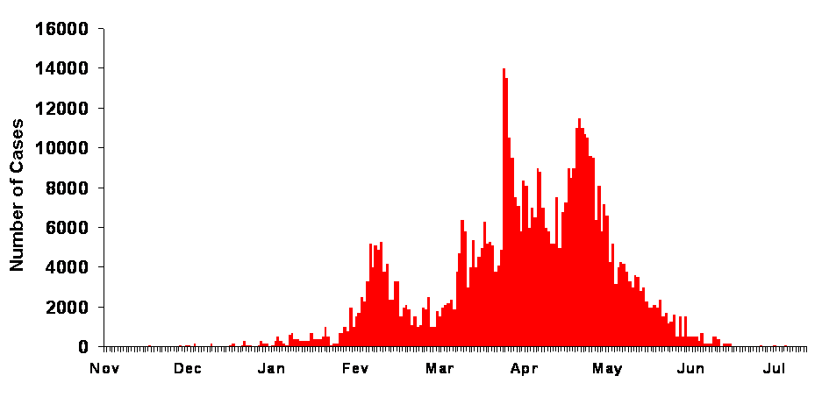
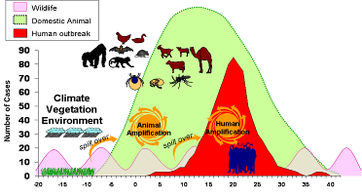
International health security
PANDEMIC Global spread
Globalization of pathogens
Global travel: people, animals, vectors
Global trade: animal products, vaccines, medical products, etc.
Global travel and trade
EPIDEMIC Amplification
Amplification of pathogens
Successful H2H transmission,
Nosocomial transmission in health care centres
New introduction from animals
Urbanization
Agricultural intensification
Technology and industry
Human to human
transmission
Amplification
OUTBREAK Emergence
Human
Animal
interface
Emergence of pathogens
Encroachment introduction, “spillover”
At-risk behaviour
Human encroachment, ex situ contact, Ecological manipulation
Translocation of wildlife

Slide 16
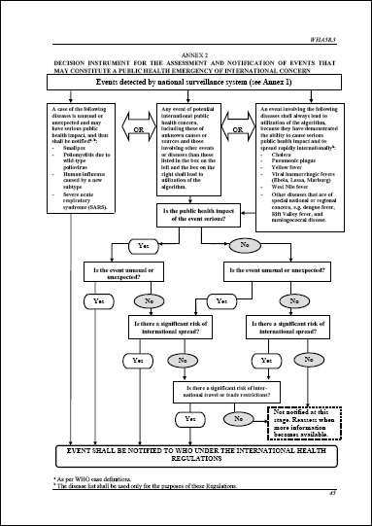
Decision instrument (Annex 2)
4 diseases that shall be notified polio (wild-type polio virus), smallpox, human influenza new subtype, SARS.
Disease that shall always lead to utilization of the algorithm: cholera, pneumonic plague, yellow fever, VHF (Ebola, Lassa, Marburg), WNF, others….
Q1: public health impact serious?
Q2: unusual or unexpected?
Q3: risk of international spread?
Q4: risk of travel/trade restriction?
Insufficient information: reassess

Slide 17
Pandemics:-
An epidemic of an infectious disease that spreads over a wide geographic area and affects a large proportion of the population.
A pandemic can start when the following conditions occur:
  Emergence of a disease, or a particular strain of a disease, new to a population.
  The agent affects humans, causing serious illness.
  The agent spreads easily and sustainably among humans (1).
  (1) Textbook of Adult Emergency Medicine

Slide 18
6- Current & Future Plans
Mass Gathering and Health (CBRNE).
Updating all plans to meet FIFA world cup 2022.
Health Security based on IHR 2005 and GHSA.
Building partnership with international centers.
Surge Capacity for all Hazards.

Slide 19

THANKS

